Slide 1
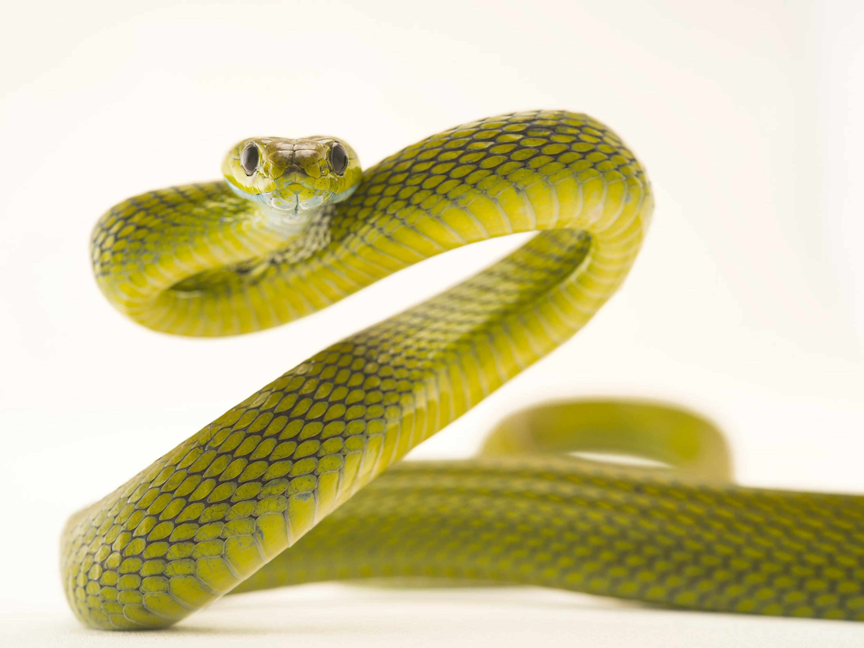
SNAKE DETECTION

Slide 2
Code:
import tensorflow as tf
import sys
import time
import cv2
import RPi.GPIO as GPIO
GPIO.setmode(GPIO.BCM)
GPIO.setwarnings(False)
buz=26
GPIO.setup(buz,GPIO.OUT)
GPIO.output(buz,0)
vs = cv2.VideoCapture(0)
time.sleep(3)
while(True):
(grabbed, frame) = vs.read()
cv2.imshow('input',frame)
if cv2.waitKey(1) & 0xFF == ord('s'):
Break
cv2.imwrite('test.jpg',frame)
cv2.waitKey(10)
image_path = 'test.jpg’
graph_file = "Venomous_nonVenomous_inception.pb"labels_txt = "snake_labels.txt“
with tf.gfile.FastGFile(graph_file, 'rb') as f: graph_def = tf.GraphDef() graph_def.ParseFromString(f.read()) _ = tf.import_graph_def(graph_def, name=‘’)
image_data = tf.gfile.FastGFile(image_path, 'rb').read()label_lines = [line.rstrip() for line in tf.gfile.GFile(labels_txt)]

Slide 3
with tf.Session() as sess:
softmax_tensor = sess.graph.get_tensor_by_name('final_result:0')
predictions = sess.run(softmax_tensor,{'DecodeJpeg/contents:0': image_data})
top_k = predictions[0].argsort()[-len(predictions[0]):][::-1] temp = ['','']
i=0
for node_id in top_k:
human_string = label_lines[node_id]
score = predictions[0][node_id]
print('%s (score = %.5f)’ %
(human_string, score))
print(score)
i=i+1
if(i==1 and score>0.5):
GPIO.output(buz,1)
print('buzzer on')
time.sleep(5)
print('buzzer off')
GPIO.output(buz,0)

Slide 4
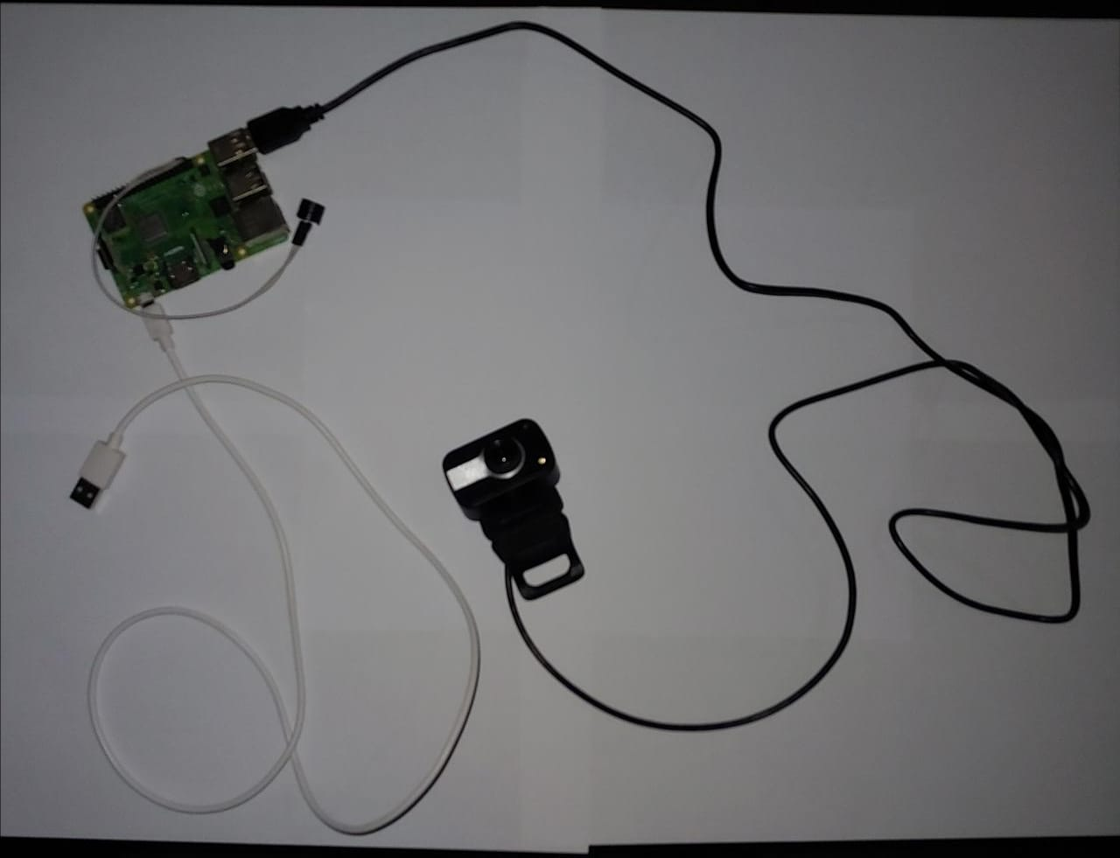
Architecture Design:

Slide 5
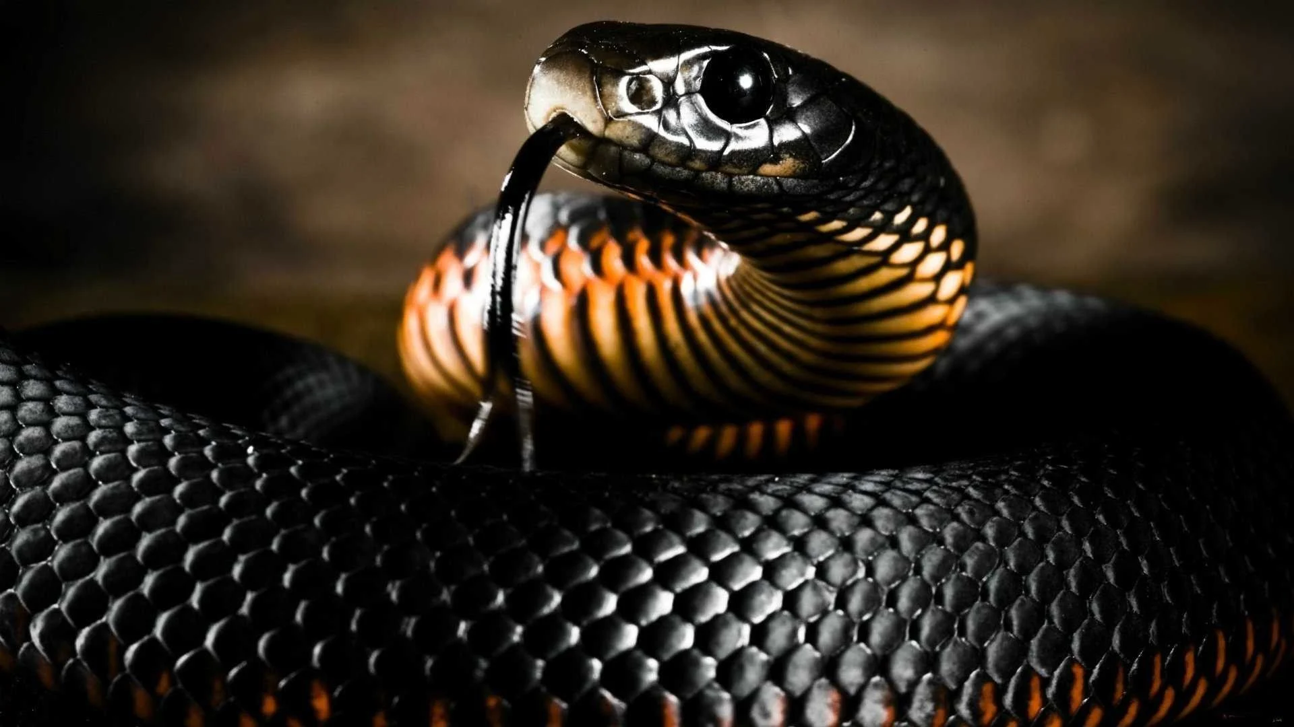
Sample Input:

Slide 6
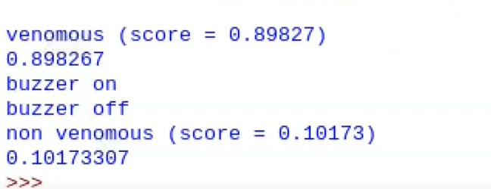
Sample Output:

Slide 7
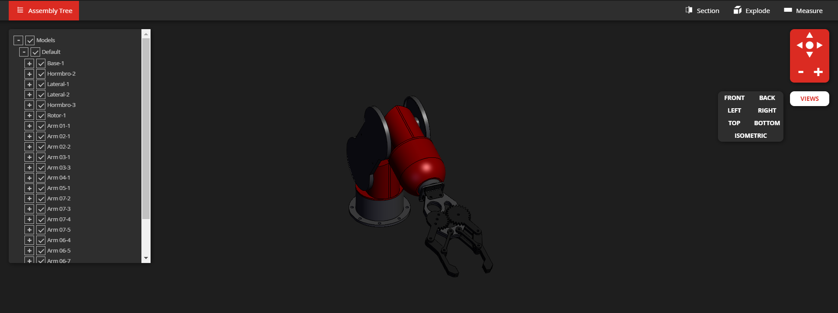
Robotic Arm 3D model Design:

Slide 8
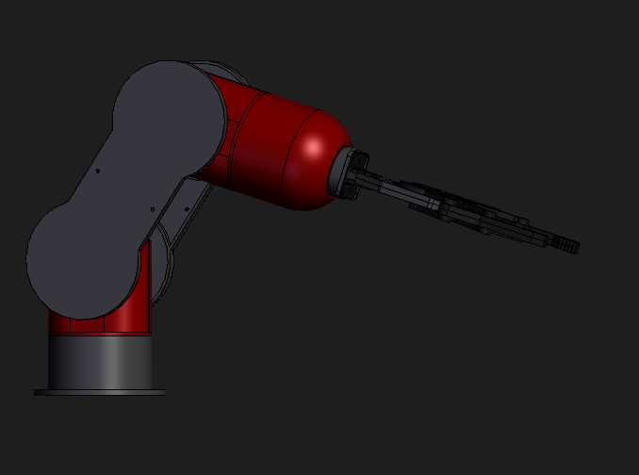
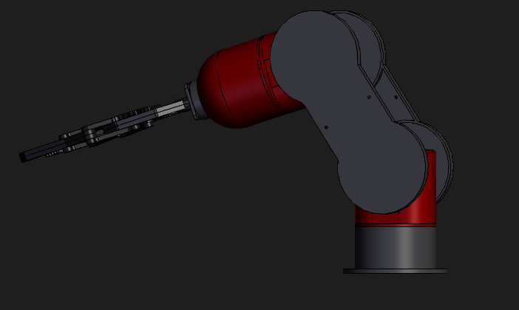
Views:
Front view:
Back view:

Slide 9
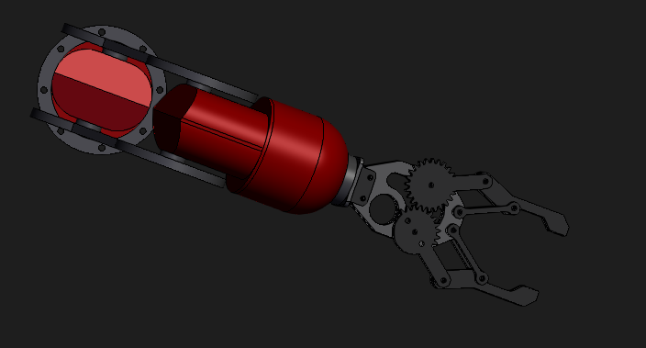
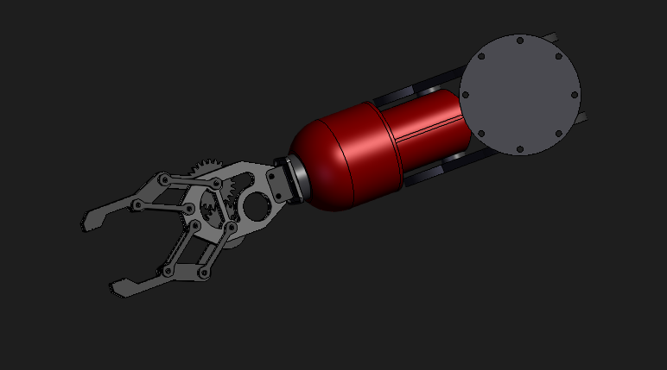
Views:
Top view:
Bottom view:

Slide 10
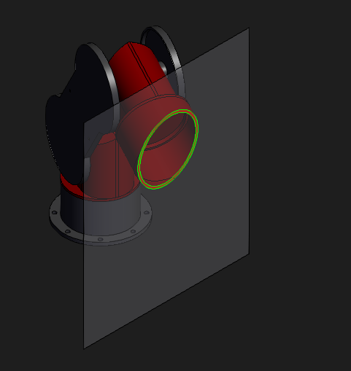
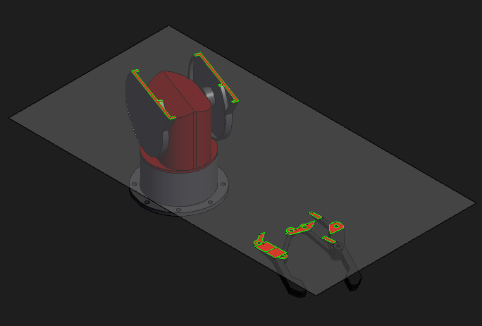
Plane orientations:
X-axis Orientation:
Y-axis Orientation

Slide 11
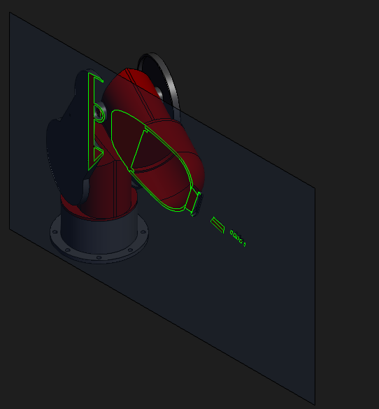
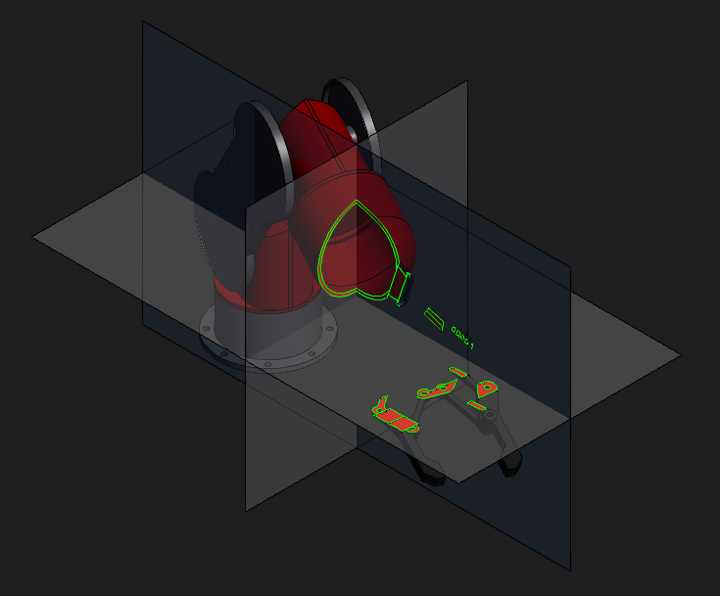
Plane Orientations:
Z-axis orientation:
XYZ Orientation:

Slide 12
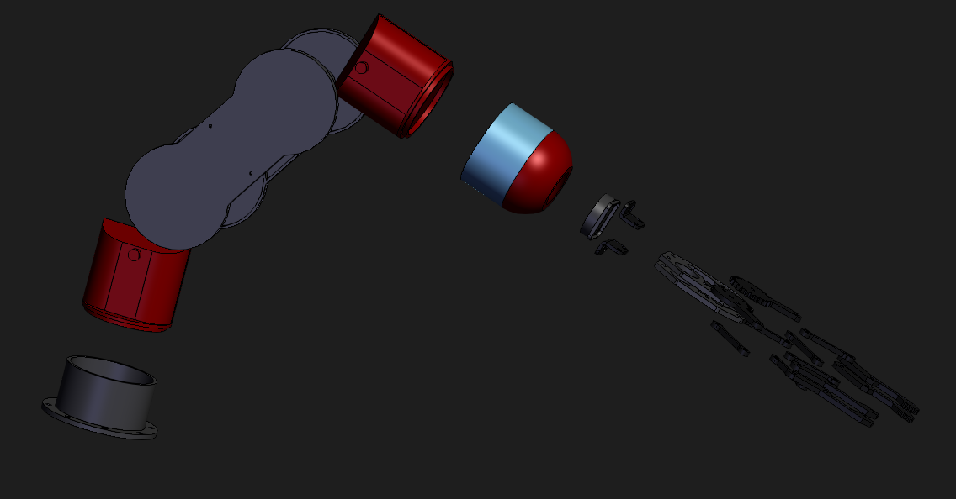
Overview of Robotic Arm:

Slide 13
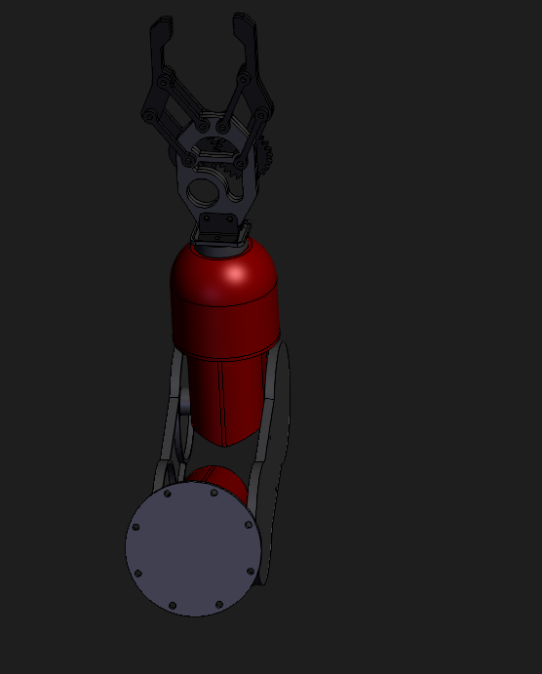
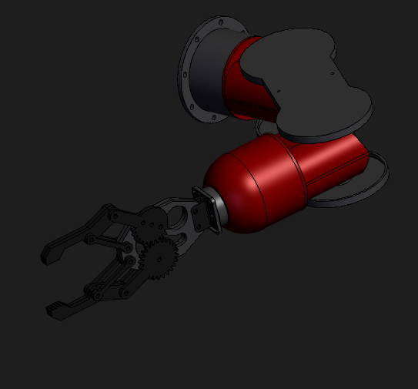
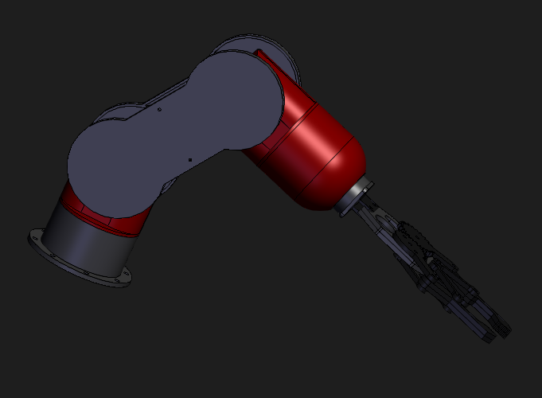
360 Degrees Rotations

Slide 14
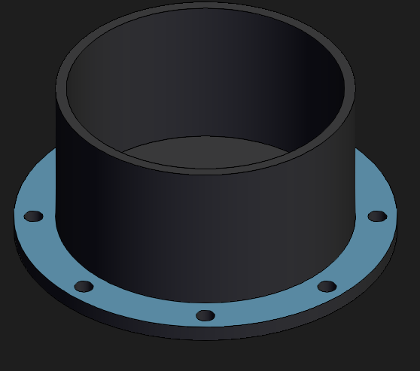
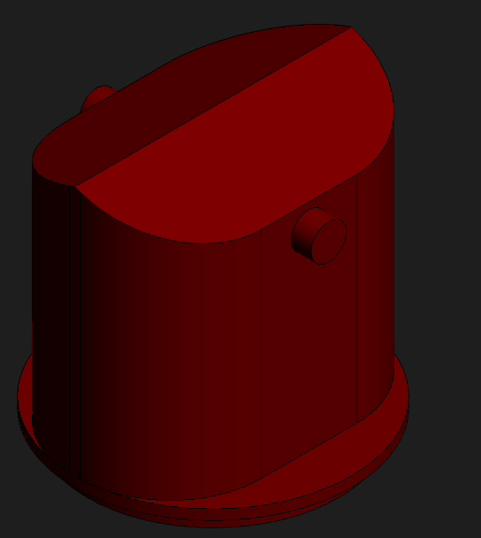
Components:
1. Base
2.Hormbro-2
The base of the robotic arm is made up of Perspex while the links are made up of Aluminium.
it has two links which rotate or work over a two-dimensional plane with each of links having a single degree of freedom.

Slide 15
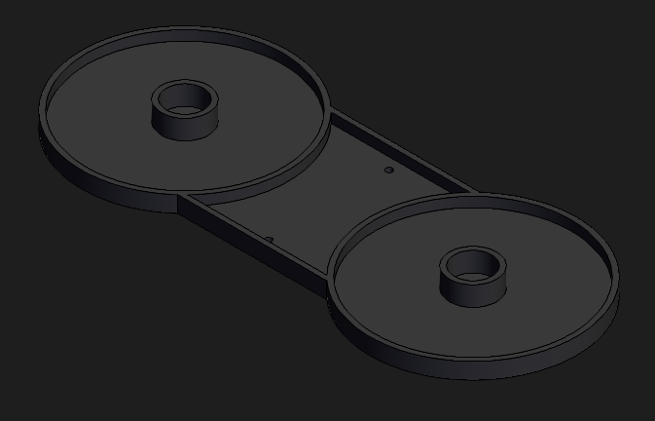
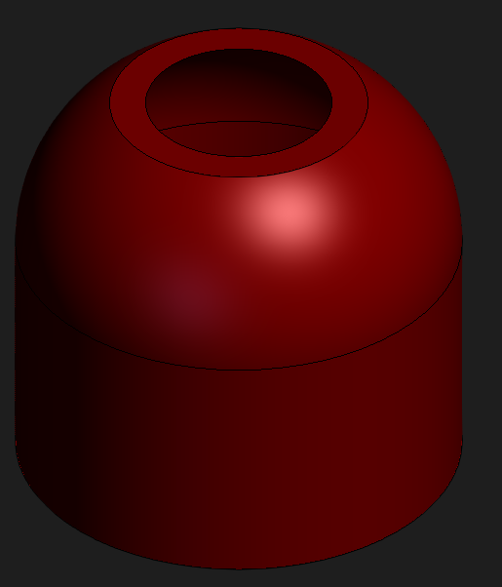
Components:
Laterals
Rotor:
Lateral is used in joints to connect
The ROTOR uses a robotic arm and sterile, ready-to-use replica plating pads to pick up samples of cells from culture plates.

Slide 16
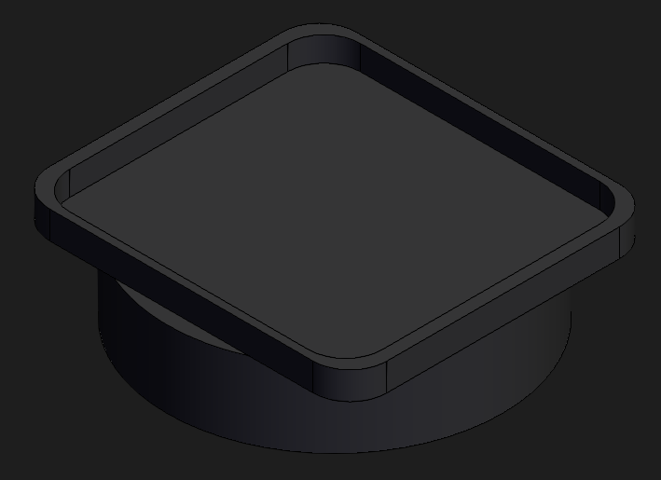
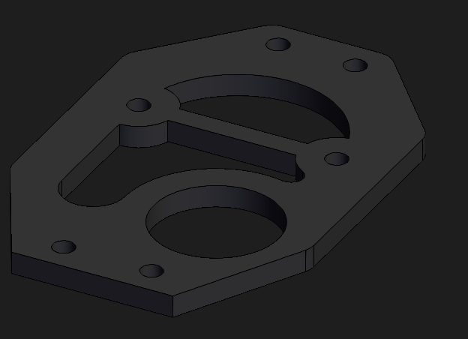
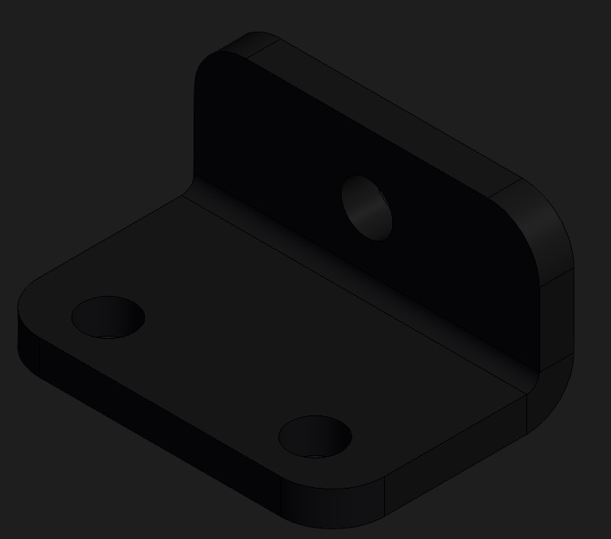
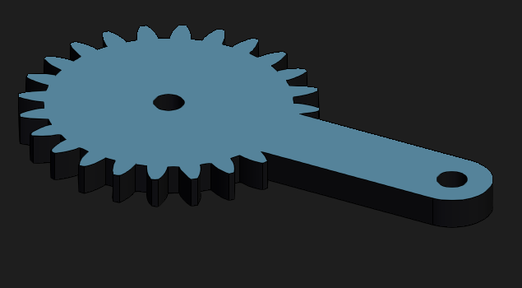
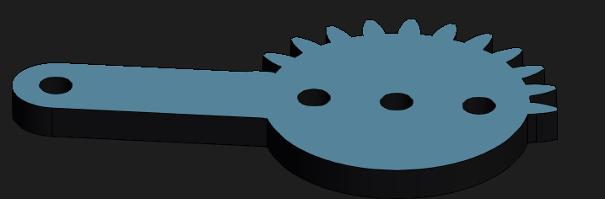
Components:
Arm-1
Arm-2
Arm-3
Arm-4
Arm-5

Slide 17
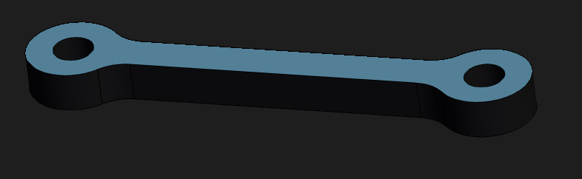
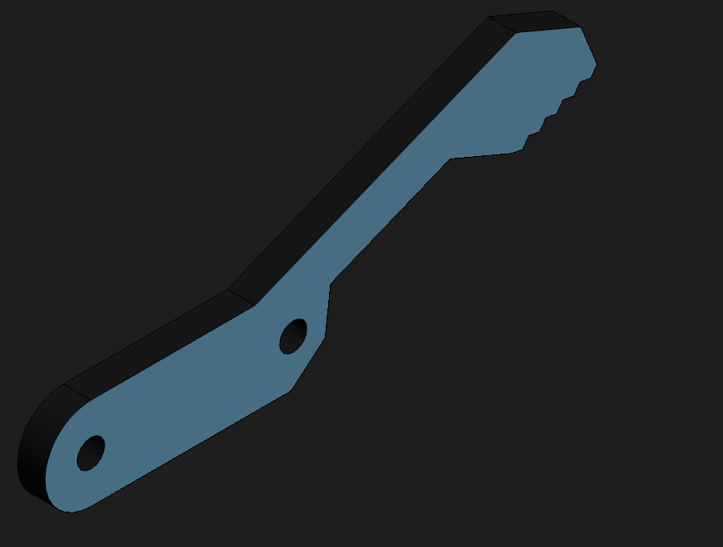
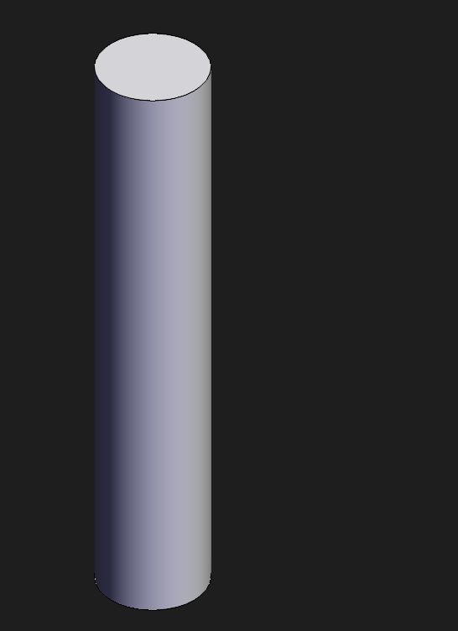
Arm-6
Arm-7
Arm-8

Slide 18


